Slide 1



INTERNATIONAL DISTRICT ENERGY ASSOCIATION’S

Slide 2
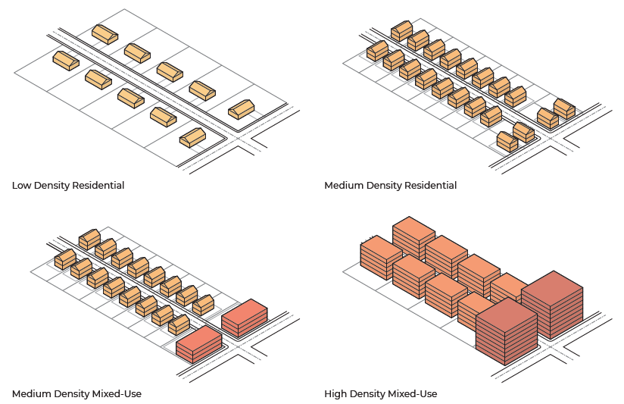


Beyond the Pipes: How Thermal Networks Advance Equity, Resilience, and Conservation
Energy harvested, moved, and reused.
The Grey Edge Group
and
Sound Geothermal Corporation
Cary Smith
dcsmith@soundgt.com
csmith@greyedgegroup.com

Slide 3
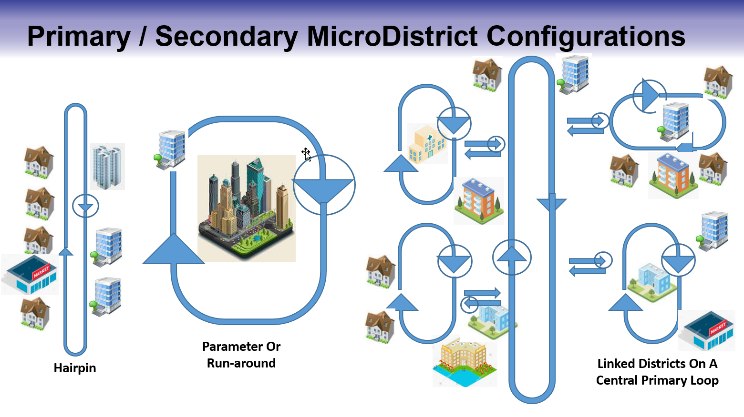
Ambient Temperature Loop (ATL)
This presentation assumes the audience has a fundamental understanding of one-pipe district systems.
An ambient temperature loop (ATL): A single pipe. non-consumptive, closed loop, heating and cooling system that circulates a heat transfer fluid at a temperature, close to the outdoor ambient temperature through a network of pipes to supply heat pump source/sink fluid.
The ATL is independently pumped, and assets (borefields, etc.) are attached in primary-secondary configuration thus hydraulically separating them from the main system.
Typically, the temperatures of the distribution system range between 45° F and 95° F.
Used for multi-building applications of any size.

Slide 4
What is the difference between a Central Loop and an Ambient Temperature Loop(ATL)?
Captures Building(s) DIVERSITY- The condition where the sum of the different building or system zone/facility loads is less than the sum of the peak operations loads.
Net loads are generally less than the sum of the peak facility loads. Usually occurring when the conditions require simultaneous heating and cooling or balanced heating and cooling.
Plug and play attachments augment the loop operation so that the system is optimal in balanced, part load, or full load.
Actively Uses boreholes as thermal storage rather than only sink/source.
An ATL harvests and stores the energy we normally throw away.
Manage the system. Driving the system transport fluid to a near-ambient conditions “makes the heat pumps happy”. Drive the system to balance.
¹ “Connected Communities: A Multi Building Energy Management Approach”, RMI, NREL, May 2020 Technical Report, NREL/tp-5500-75528
² “A Guide to Energy Master Planning of High-Performance Districts and Communities” A Guide to Energy Master Planning of High-Performance Districts and Communities. Golden, CO: National Renewable Energy Laboratory. NREL/TP-5500-78495. https://www.nrel.gov/docs/fy21osti/78495.pdf. L Presentation
Notes:
50/90 RULE, AFFINITY LAWS, THERMAL STORAGE.
The numerator is the sum of the annual peak loads in individual buildings, and the denominator is the annual peak load of the multi-building community. Thus, a diversity factor of 1 means the peak loads of the individual buildings are perfectly coincident with each other, while a diversity factor of 2 implies that the community peak is half the sum of the individual building peaks. As a general rule, the higher the diversity factor of a set of buildings, the more benefit that can be derived by sharing resources across buildings. It’s important to note, for siting considerations, that shared systems could be in the form of central installations connected to multiple buildings or distributed installations that are connected by virtue of being behind the same master meter and POI with the utility grid.
Also, using 8760 hours gives the opportunity to enhance the performance of the Thermal Highway©

Slide 5
Colorado Mesa University Total Connected Load
2025 Attached Buildings: 1,669,235 SF
Cumulative System Load
4,179 tons of heating (building)
4,502 tons of cooling (building)
Field Capacity and Peaking Equipment Capacity
2,231 tons of heating (loop field) + 883 tons boilers (usually not used)
1,878 tons of cooling (loop field) + 2,850 tons towers (peaking only)
696 boreholes or 81.8 feet per ton
Diversity Factors - 48% heating / 52% cooling
Flow and Temperature Range
Typical Maximum flow 4,800 GPM
Typical Minimum flow 850 GPM
Average flow 2,200 GPM
Min temp (winter) 45°F; max temp (summer) 95°F

Slide 6
Part load analysis is your friend
The majority of the energy used in an ATL is pump power,
Use the Pumping affinity laws to optimize pumping.
Remember:
1/2 reduction in flow (+/- 7,000 hours per year) yields:
Reduced fluid friction to 1/4 of full load head loss.
Reduced power consumed to 1/8 of full load use.

Slide 7
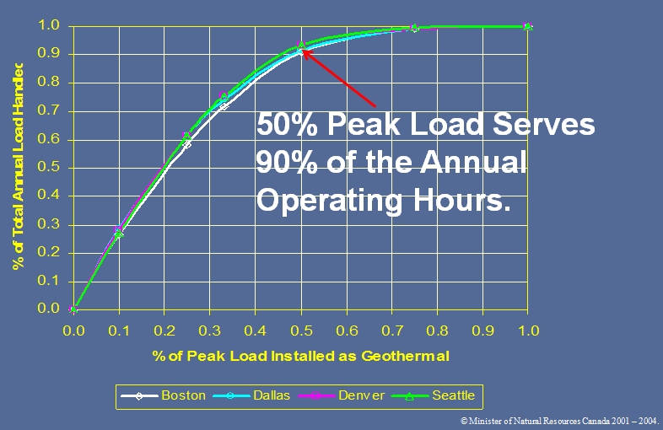
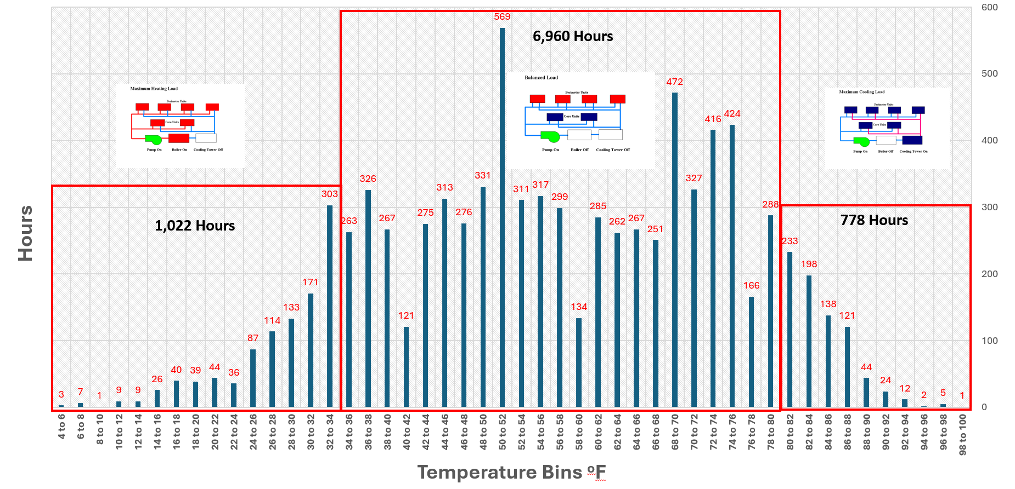
Part Load Analysis, The core of DESIGN of an ATL
% of Peak Load vs. % of Annual Hours
Sample Bin Data

Slide 8
Electric Demand – Power Requirement – Load leveling
800,000 sq. ft.
1,200,000 sq. ft.
4 Mw
3 Mw
New Library coming on-line and students return.
1 MW CHP would provide significant demand reduction and help keep the demand window between 3 and 4 MW.

Slide 9
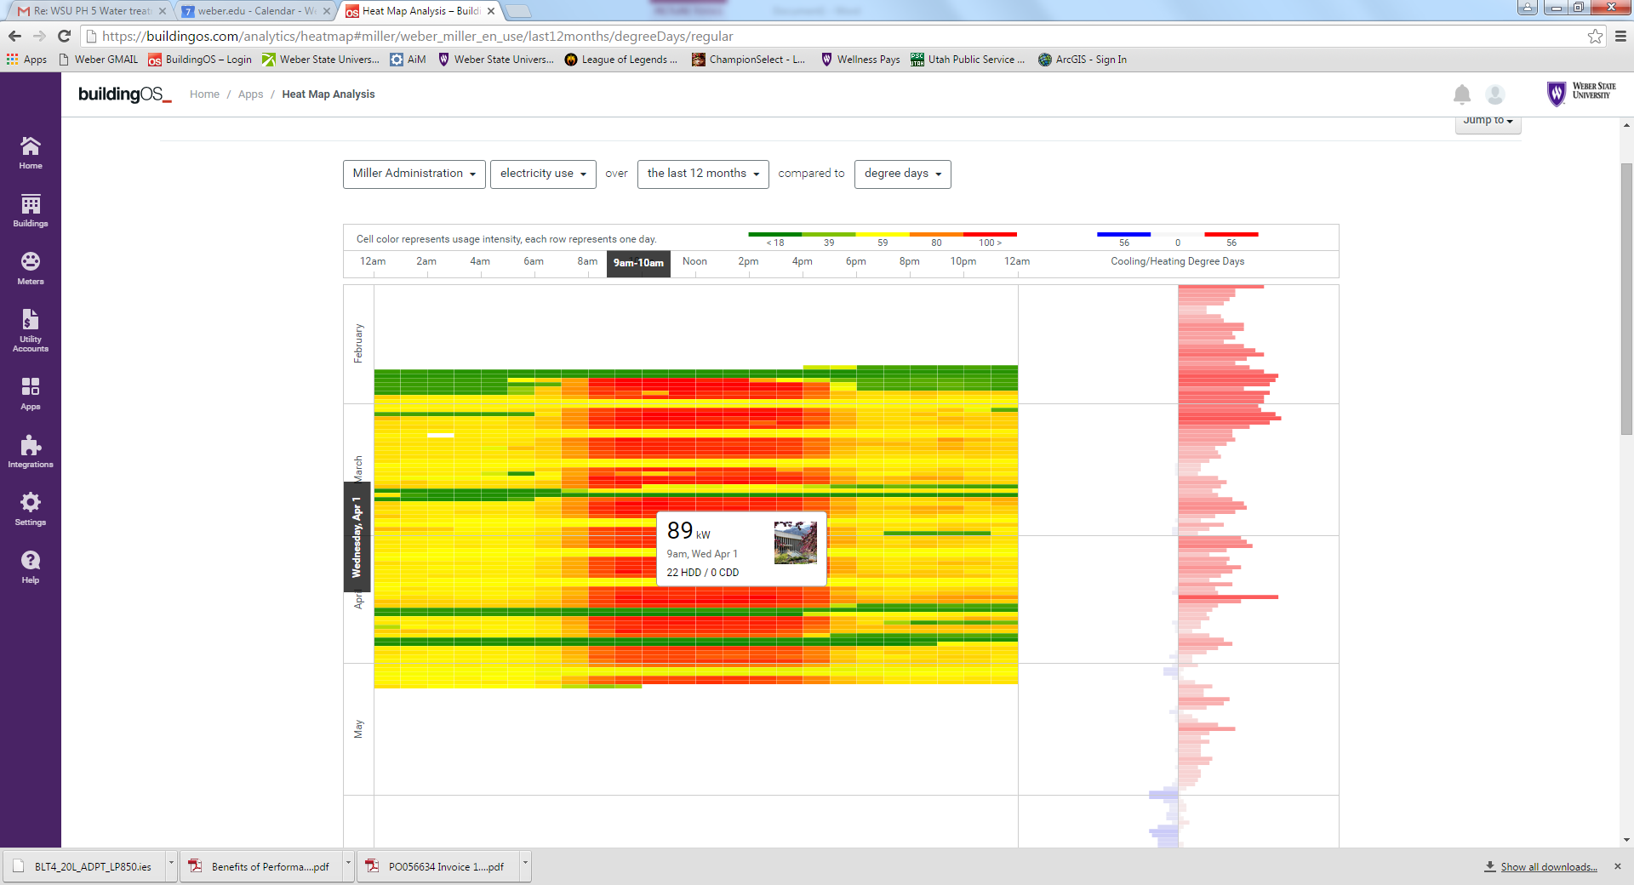
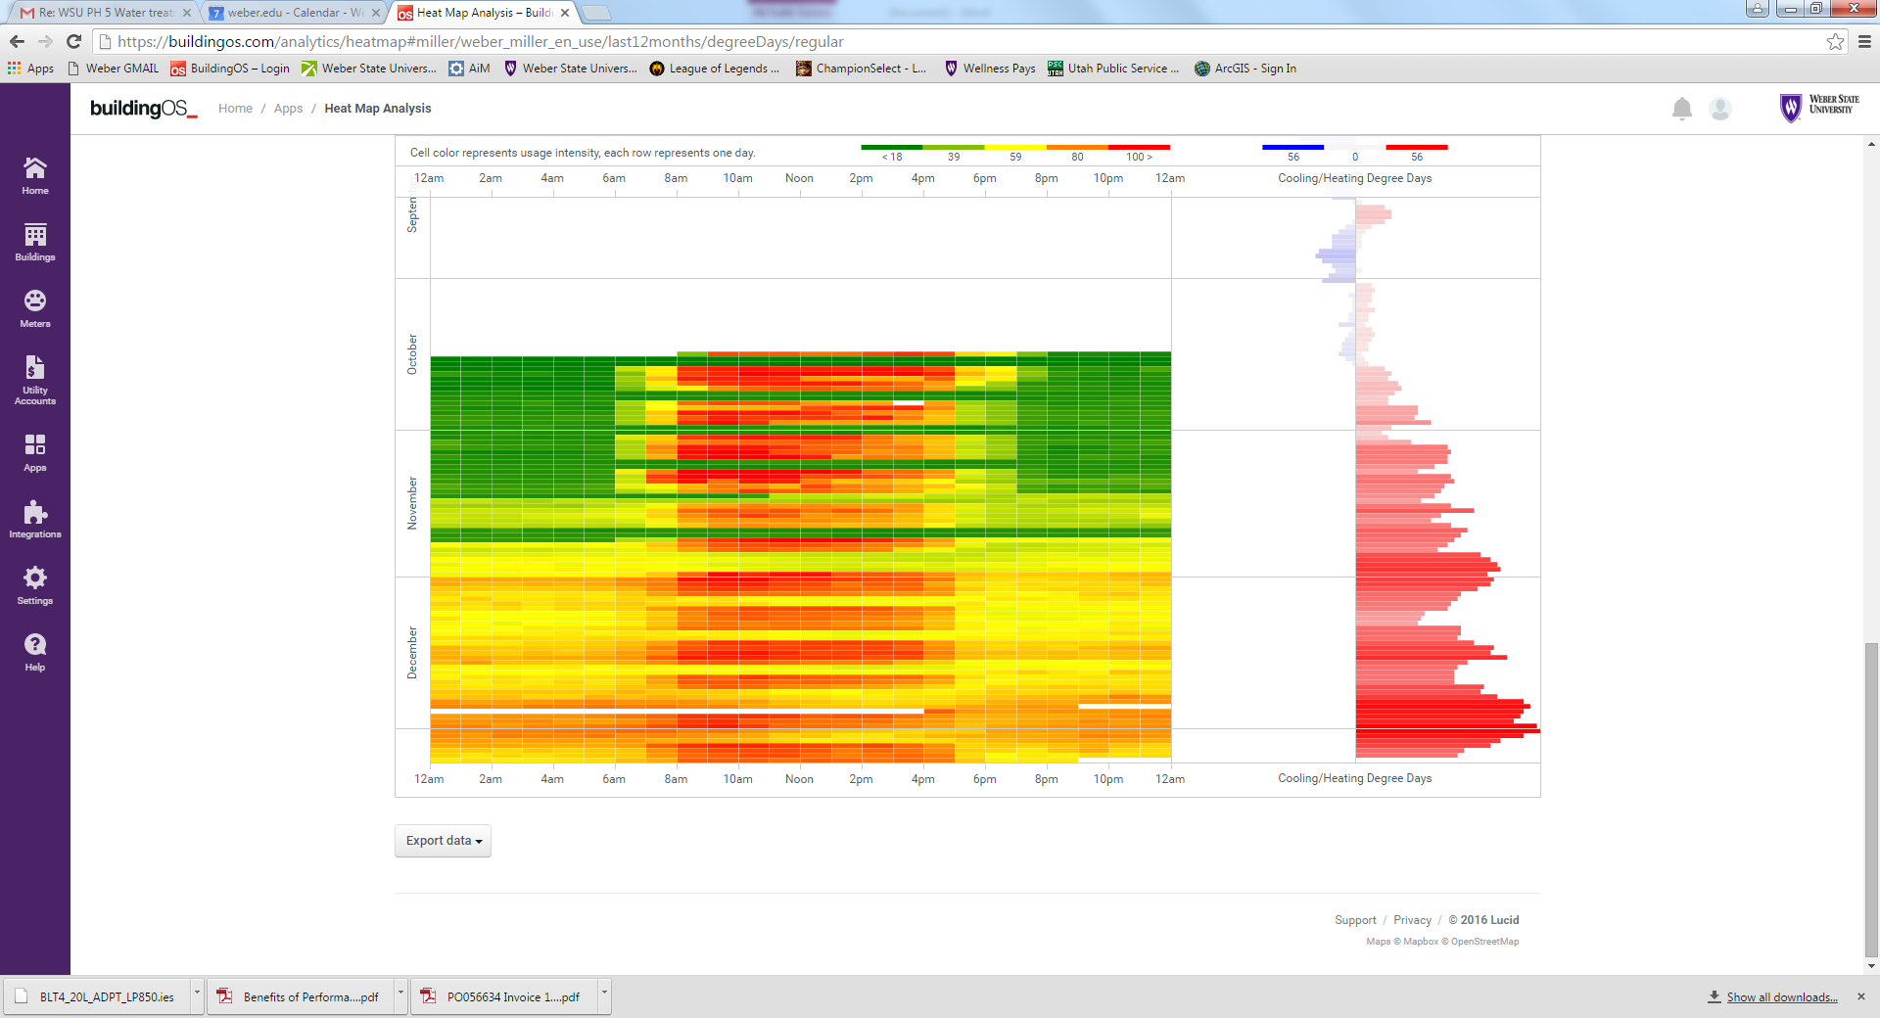
Leveling Load: WSU Initial Economic Results
~39% of Normal
Energy Intensity for one 400,000 sq. ft. Section – RED Area is mid-day-energy concentration.
Before Heat Pumps and Central System
EUI 89
EUI <35
Before: Central Plant fuel costs: $12,800 per month (January).
After: Start-up of Central Loop System fuel costs: $2,700/month (January).
After

Slide 10

System Water Savings
Goal: Optimize energy savings and minimize water use.
Reduce cooling tower water and reduce electric load.
Without District System:
Towers Required ~ 4,400 tons ( Nominal plus CT energy)
Calculated water use: 29 MM gallons/yr. (2,400 EFLRH)
Load 1,568 kW
With District System:
Existing tower system: 1,500 tons used
Estimated Water Use: 9 MM gallons/yr. (2,400 EFLRH)
Load: 370 kW
Reduce or eliminate combustion for heating and domestic hot water.
Tower Energy Savings: ~ $230,000/yr

Slide 11
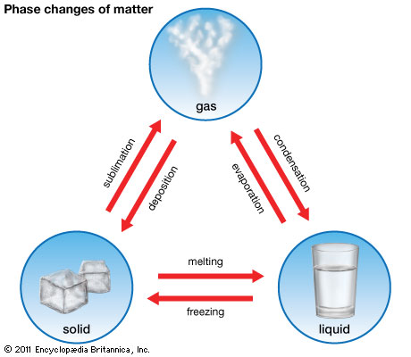

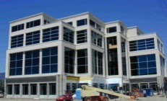
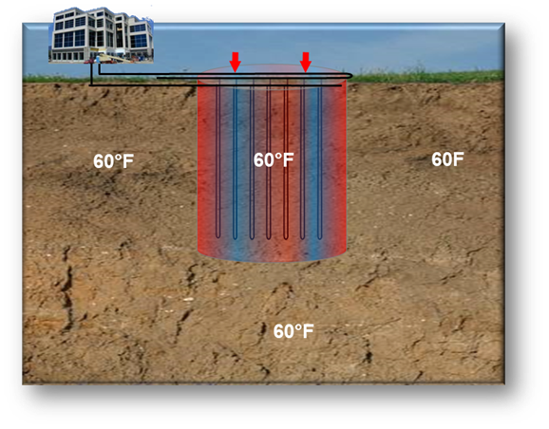
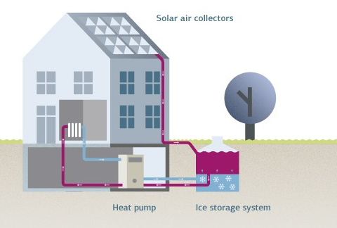
Borefield Use Changes From Sink/Source to Thermal Storage
Closed Loop – Primary Battery
Open Loop
Magic of controls: Floor to floor temporary storage
Phase Change – additional thermal storage and system stability

Slide 12
Thermal Storage Test – Volumetric Heat Capacity
Borehole Loading response – Deep earth temp from TC test is ~ 60°F.
Putting diffusivity to work in your favor:
Test One
1. At peak cooling, we loaded a field with 95°F ATL fluid and stabilized the field 91°F to return temperature (~8 hours).
Shut-in field for 24 hours. After 24 hours we checked the return temperature, the field fluid return temperature was reduced to 84°F.
Test Two
2. At peak cooling, we loaded a field with 95°F ATL fluid and stabilized the field 91°F return temperature (~8 hours).
Shut-in field for two weeks. Field fluid return temperature was reduced to 64°F.
.

Slide 13
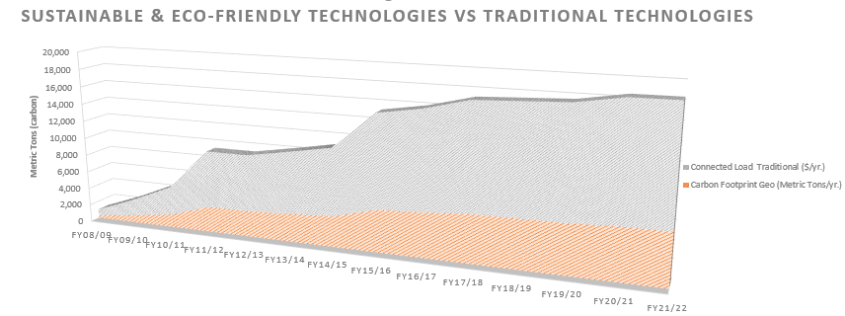
Reduce Carbon Footprint
Reduction in boiler use: Carbon footprint has been reduced by 10,114 metric tons/yr. Boiler use is less than 6%/yr.

Slide 14
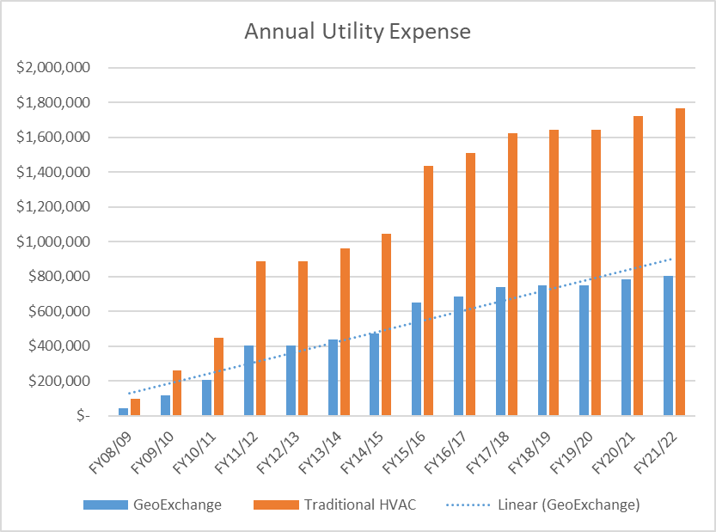
Reduce Annual Utility Spend
Notes:
A traditional heating ventilation and air conditioning (HVAC) system can consume as much as 22 kWh/sf/yr.
A GeoExchange system consumers about 10 kWh/s.f./yr.
The campus GeoExchange system provides up to 89% of the energy needed to heat and cool connected buildings (1,139,860 sf), resulting in energy savings in excess of $1,094,268.60 / year.
Conservative estimates show our Carbon footprint has been reduced by 7,881 metric tons/yr through the use of our GeoExchange system when compared to traditional HVAC systems.

Slide 15
What we learned -1:
The borehole purpose shifts from source/sink to thermal storage
Storage provides time for the system to respond
Borehole total length required is reduced. (220 ft to 81 ft at CMU.)
Borehole response-time was more important than we thought.
Load shifting is minute to minute from the near-field or season to season from the far-field.
Demand reduction is typical.
Low system operating “delta T” and a wider temperature range (45 ° F - 95 ° F) across the system increases resiliency.
Stable temperatures in the Central Loop were the norm.

Slide 16
What we learned - 2:
Water consumption at cooling towers is reduced significantly
Low pump speeds were normal, low energy consumption due to the affinity laws was the norm
Extended circulating time lag was an asset that stabilized the system
Opportunity to use potable water, irrigation, black/grey-water, and other assets
Building isolation was easy – Strategy: on loss of Fluid anywhere in the system.
Isolation of microdistricts was easy

Slide 17
Comments:
Colorado Mesa University and Weber State University are good engineering models to review:
50/90 rule works and enhances carbon reduction
Peak Load Design vs “Balanced Load Design” (Part load analysis)
Diversity can become your biggest asset
Use plug and play devices to balance systems
Plan for expansion
New and retrofit are both candidates for an ATL system

Slide 18
Integrated Plug and Play Electric / Thermal Energy Systems
Cooling Heating Dominant Balanced Dominant
Solar PVT
Buildings
Residential, Commercial, Industrial
PV Panels
Heat Exchange Panels
Electric Storage
Vehicle Charging
Multi-Source Heat Pumps
Chillers
Wastewater Heat Exchangers
Industrial Waste Heat Capture
Air Source Heat Pumps
Ground Source Heat Pumps
Conventional CHP
Cooling Towers
Recycled Thermal Energy
Inter-Connected Thermal Distribution Circuits
Micro-Grid Isolation
Ambient Temperature Water
Emissions Free Electric Power
Emissions Free CHP+S Sites
Emissions Free CHP+S Sites
Ground Heat Exchangers
Electric Storage
Thermal Storage
Run-of-River Turbines
Water Source Heat Exchangers
Telecom
Utility Solar PVT Farm
Grid-Enabled Monitoring & Intelligent Control
Heat Exchanger Panels
PV Panels

Slide 19
Questions?
The GreyEdge Group
and
Sound Geothermal Corporation
Cary Smith
dcsmith@soundgt.com
csmith@greyedgegroup.com

Slide 20
Auxiliary Slides Not Used

Slide 21
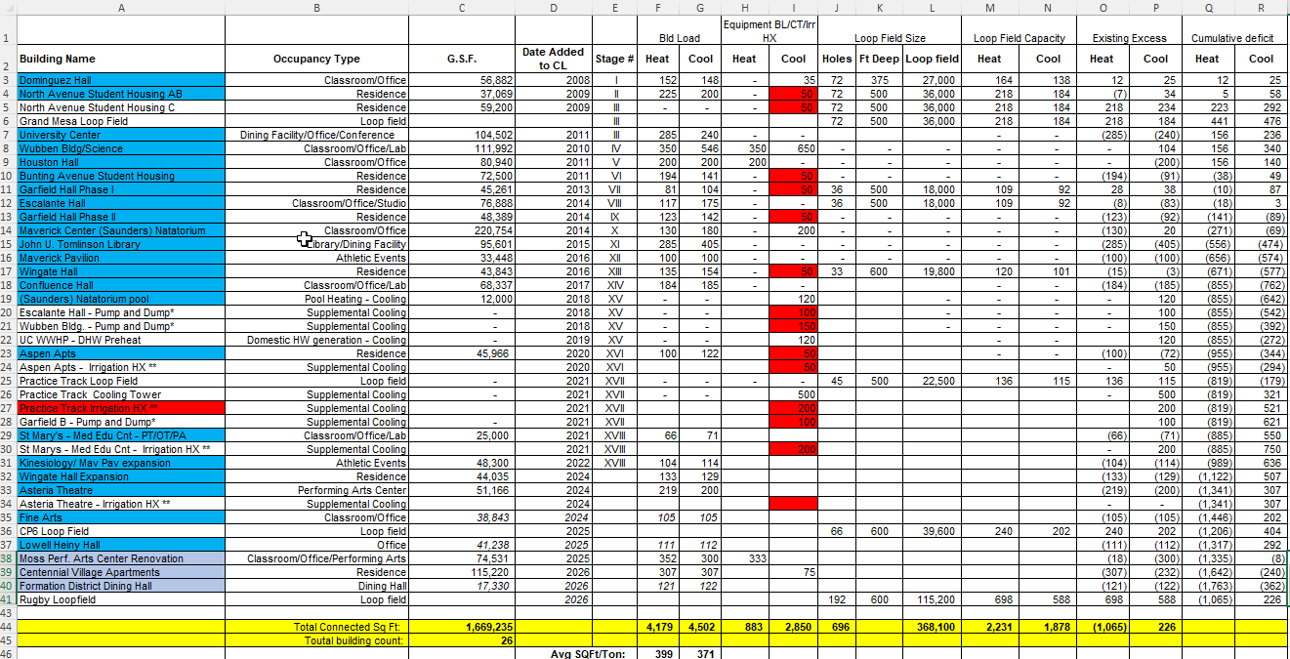

Slide 22
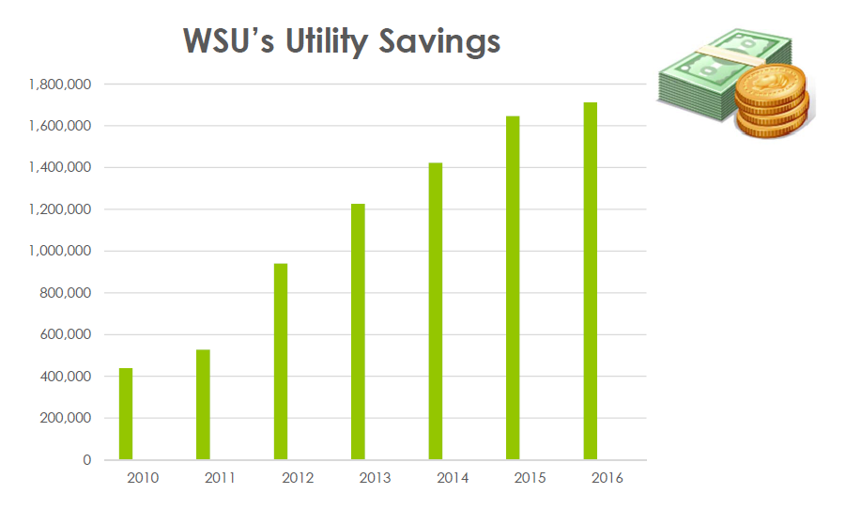
Result and Rewards
Direct greenhouse gas emissions reduced by 31% since the baseline year of 2007
(Even with the addition of 375,210 s.f. – (~15% increase)
Electricity Consumption down by 29%
Natural gas consumption down by 33%
Energy cost down ~40%

Slide 23
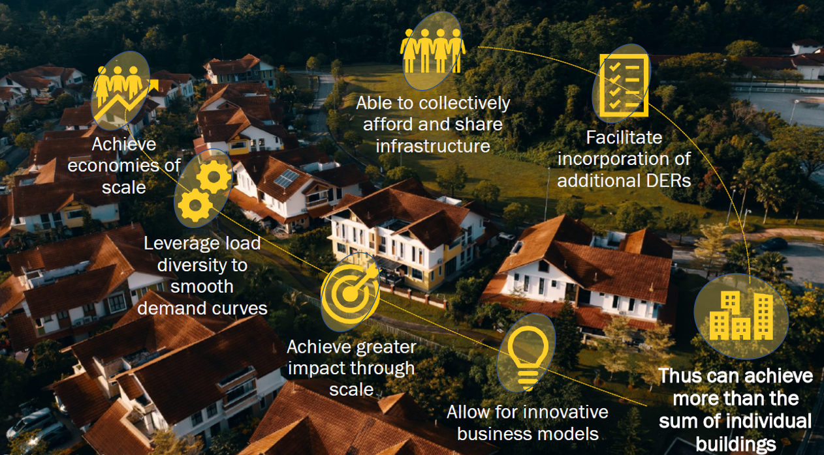
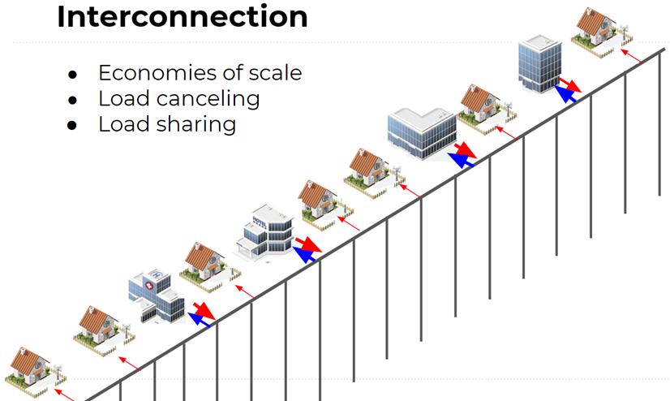
Grid Enabled Networks – Type 5 and Up (DOE Project DE-FOA-0002291 May 2020)
DOE Grid Enabled Network: The illustration (left) suggests that the full integration of smart devices, building envelope improvement as well as the impact of incorporating the improvements AT SCALE is the heart of the demonstration.

